Slide 1
We’re competing!
1

Slide 2
About the School Competition
KSBA-SEMP is hosting Kentucky’s Battle of the School Buildings
Kentucky schools compete with each other to see who can reduce their energy the most!
Modeled off the ENERGY STAR program the National Battle of the Buildings
Additionally, with just one-click you can also compete in the 2016 National Battle of the Buildings
Kentucky’s Battle of the School Buildings will recognize | Criteria
Overall Top Building* | Percentage-based reduction in energy use from 2015 to 2016
20% Building Reduction* | 20% or more reduction in energy use from 2015 to 2016
2

Slide 3
About the School Competition (continued)
Using the resources from ENERGY STAR
Schools will compete to reduce Calendar Year 2016 energy use compared to a Calendar Year 2015 baseline
School progress tracked quarterly at www.ksba/semp.aspx
3

Slide 4
About the School Competition (continued)
Competition dates:
3/31/16 Enter FY 2014-15 data into Portfolio Manager,
3/31/16 Listing of energy practices contribute to reduction
5/15/16 Report 1st Quarter energy usage into Portfolio Manager
8/15/16 Report 2nd Quarter energy usage into Portfolio Manager
11/15/16 Report 3rd Quarter energy usage into Portfolio Manager
3/15/17 Report 4th Quarter energy usage into Portfolio Manager
5/2017 Winners announced
4

Slide 5
About Our Building(s)
Name of building
Square footage
Starting weight
Our goals:
If we reduce energy use by 10%, we’ll save:
<X> kBtus
<X> in energy cost savings!
Insert a photo of your building here
5

Slide 6
A few things to know . . .
School buildings are occupied only about 25 percent of the time.
How is your school heated?
How is your school cooled?
What is the temperature when school is in session?
What is the temperature when school is not in session?

Slide 7
How Can You Help?
[Optional: add building-specific actions]
Turn off lights when daylight is sufficient.
Activate power management settings and turn off your computer and monitor when not in use.
Unplug electronics such as cell phones and laptops once they are charged.
Keep air vents clear of paper, files, and office supplies.

Slide 8
How Can You Help?
CONSIDER asking others in the building to dress appropriately for the weather.
Make sure doors and windows are closed. Conditioning the open space outside of your buildings is not a good use of your dollars – that chair propping open the gym door is not only an energy waster, but also a security risk.

Slide 9
How Can You Help?
If you have an HVAC control system, use it; make sure building maintenance personnel are trained and understand its operation.
If you don’t have a control system, are you setting back the room thermostat a few degrees when you leave? (talk to your building maintenance personnel to know what temperature to setback)

Slide 10
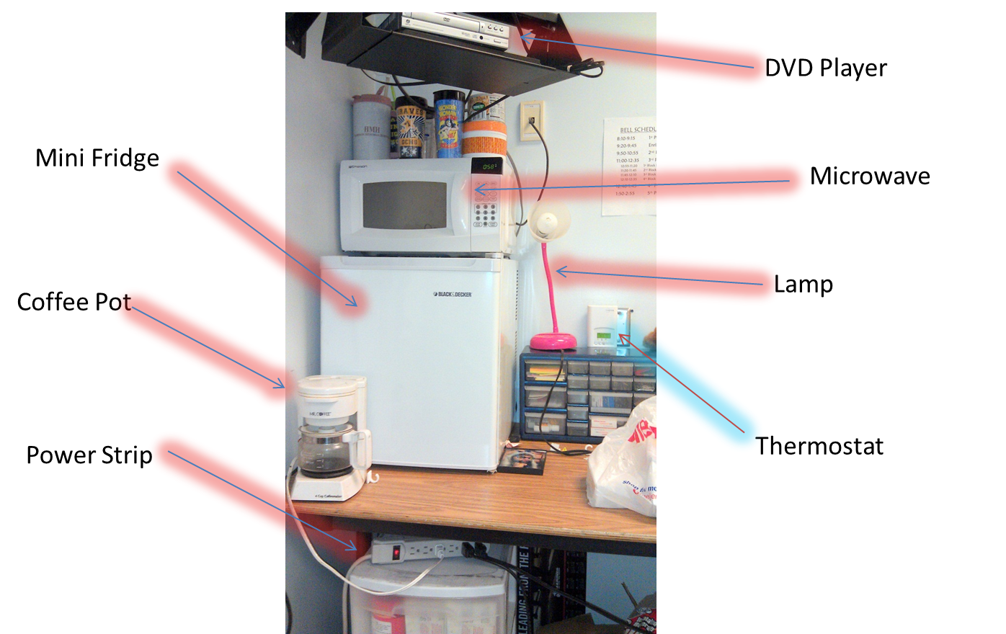
Test yourself . . . See any opportunities?

